Slide 1
Artificial Intelligence (CS-793C)

Slide 2
Course Objectives
To be able to use techniques, skills, and tools necessary for solving specific engineering problems.
To be able to apply concepts relevant to the subject and be able to design, implement, and evaluate a computer-based system, process, component, or program to meet desired needs.
To understand the role of knowledge representation, problem solving, and learning in intelligent-system engineering

Slide 3
Course Outcomes
Understand fundamentals of knowledge representation, and logic based reasoning.
Apply knowledge representation and reasoning to analyze and solve real- world problems.
Demonstrate working knowledge in Prolog in order to write simple Prolog programs and be able to explore more sophisticated Prolog code on their own.
Demonstrate working knowledge in Lisp in order to write simple Lisp programs and be able to explore more sophisticated Lisp code on their own.
To develop basic rules for an expert system.
To develop individually or in teams, simple knowledge-based systems and communicate effectively.

Slide 4
Development
PROgramming in LOGic
It is the most widely used logic programming language
Kowalski: late 60’s Logician who showed logical proof can support computation.
Colmerauer: early 70’s Developed early version of Prolog for natural language processing, mainly multiple parses.
Warren: mid 70’s First version of Prolog that was efficient.

Slide 5
Logic programming
Programmer defines facts and rules and gives this to the logic program
Ask it what programmer wants to know
Program will look and reason, using available facts and rules, and then give an answer (or answers)

Slide 6
Logic Programming (contd.)
Axiom are written in a standard form known as Horn clauses
A Horn clause consists of a consequent (head H) and a body (terms B_{i})
H ← B₁, B₂,…, B_{n}
Semantics: when all B_{i} are true, we can deduce that H is true

Slide 7
ABout
Prolog is a declarative language
A program is a collection of axioms from which theorems can be proven.
Rather than describing how to compute a solution, a program consists of a data base of facts and logical relationships (rules).
Rather then running a program to obtain a solution, the user asks a question. When asked a question, the run time system searches through the data base of facts and rules to determine (by logical deduction) the answer

Slide 8
ABout
Prolog approximates first-order logic.
Every program is a set of Horn clauses.
Inference is by resolution.
Search is by backtracking with unification.
Basic data structure is term or tree.
Variables are unknowns not locations.
Prolog does not distinguish between inputs and outputs. It solves relations/predicates.

Slide 9
Resolution
Horn clauses can capture most logical statements
But not all
The derivation of new statements is known as resolution
The logic programming system combines existing statements to find new statements
For instance,
C ← A, B
D ← C
D ← A, B
A and B imply C
If we know that A and B imply C,
and that C implies D,
then we can deduce that A and B imply D

Slide 10
Example
Variable
flowery(X) ← rainy(X)
rainy(Rochester)
flowery(Rochester)
Predicate Applied to a Variable
Predicate Applied to an Atom
Free Variable X acquired value
Rochester during the resolution
This is known as Unification

Slide 11
Prolog as a declarative language
Clauses are statements about what is true about a problem, instead of instructions how to accomplish the solution.
The Prolog system uses the clauses to work out how to accomplish the solution by searching through the space of possible solutions.
Not all problems have pure declarative specifications. Sometimes extra logical statements are needed.

Slide 12
Prolog programming model
A program is a database of (Horn) clauses that are assumed to be true.
The clauses in a Prolog database are either facts or rules. Each ends with a period.
A fact is a clause without a right-hand side.
rainy(asheville).
A rule has a right-hand side.
snowy(X) :- rainy(X), cold(X).
The token :- is the implication symbol.
The comma (,) indicates “and”

Slide 13
Complete Syntax of Terms
Term
Constant
Compound Term
Variable
Names an individual
Names an individual
that has parts
Atom
Number
likes(john, mary)
book(dickens, Z, cricket)
f(x)
[1, 3, g(a), 7, 9]
-(+(15, 17), t)
15 + 17 - t
X
Gross_pay
Diagnosis
_257
_
alpha17
gross_pay
john_smith
dyspepsia
+
=/=
’12Q&A’
0
1
57
1.618
2.04e-27
-13.6

Slide 14
Prolog Clauses
A query or goal is a clause with an empty left-hand side. Queries are given to the prolog interpreter to initiate execution of a program.
Each clauses is composed of terms:
Constants (atoms, that are identifier starting with a lowercase letter, numbers, punctuation, and quoted strings)
E.g. curry, 4.5, +, ‘Hi, Mom’
Variables (identifiers starting with an uppercase letter)
E.g. Food
Structures (predicates or data structures)
E.g. indian(Food), date(Year,Month,Day)

Slide 15
structures
Structures consist of an atom called the functor and a list of arguments
E.g. date(Year,Month,Day)
E.g.
T = tree(3, tree(2,nil,nil), tree(5,nil,nil))
Functors
3
2
5

Slide 16
Compound Terms
The parents of Spot are Fido and Rover.
parents(spot, fido, rover)
Functor (an atom) of arity 3.
components (any terms)
It is possible to depict the term as a tree:
parents
spot
fido
rover

Slide 17
ATOM
Any atom may be designated an operator. The only purpose is for convenience; the only effect is how the term containing the atom is parsed.

Slide 18
Prolog program structure
Programs consist of procedures.
Procedures consist of clauses.
Each clause is a fact or a rule.
Programs are executed by posing queries.

Slide 19
Example
Predicate
Procedure for elephant
Facts
elephant(george).
elephant(mary).
elephant(X) :- grey(X), mammal(X), hasTrunk(X).
Rule

Slide 20
example
?- elephant(george).
yes
?- elephant(jane).
no
Queries
Replies

Slide 21
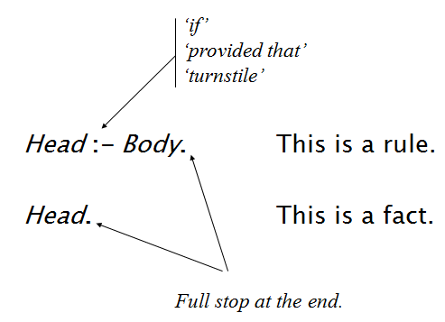
Clauses: Facts and Rules

Slide 22
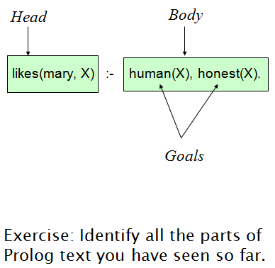
Body of a (rule) clause contains goals.

Slide 23
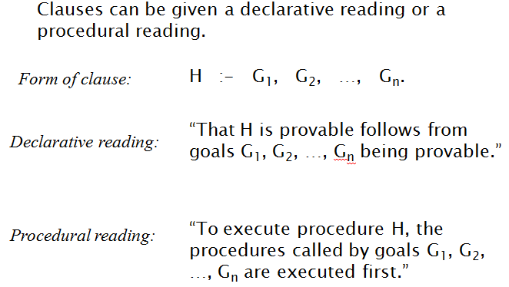
Interpretation of Clauses

Slide 24
Principle of Resolution
Prolog execution is based on the principle of resolution
If C₁ and C₂ are Horn clauses and the head of C₁ matches one of the terms in the body of C₂, then we can replace the term in C₂ with the body of C₁
For example,
C₁: likes(sam,Food) :- indian(Food), mild(Food).
C₂: indian(dahl).
C₃: mild(dahl).
We can replace the first and the second terms in C₁ by C₂ and C₃ using the principle of resolution (after instantiating variable Food to dahl)
Therefore, likes(sam, dahl) can be proved

Slide 25
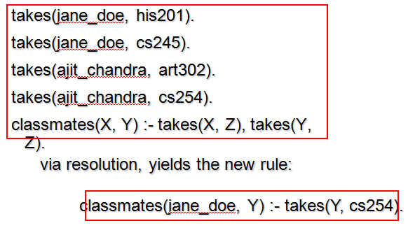
Another Example

Slide 26
Unification
Prolog associates variables and values using a process known as unification
Variable that receive a value are said to be instantiated
Unification rules
A constant unifies only with itself
Two structures unify if and only if they have the same functor and the same number of arguments, and the corresponding arguments unify recursively
A variable unifies to with anything

Slide 27
Equality
Equality is defined as unifiability
An equality goal is using an infix predicate =
For instance,
?- dahl = dahl.
Yes
?- dahl = curry.
No
?- likes(Person, dahl) = likes(sam, Food).
Person = sam
Food = dahl ;
No
?- likes(Person, curry) = likes(sam, Food).
Person = sam
Food = curry ;
No

Slide 28
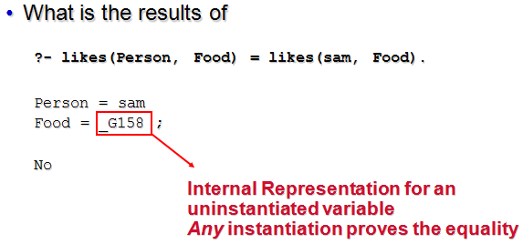
Equality

Slide 29
Execution Order
Prolog searches for a resolution sequence that satisfies the goal
In order to satisfy the logical predicate, we can imagine two search strategies:
Forward chaining, derived the goal from the axioms
Backward chaining, start with the goal and attempt to resolve them working backwards
Backward chaining is usually more efficient, so it is the mechanism underlying the execution of Prolog programs
Forward chaining is more efficient when the number of facts is small and the number of rules is very large

Slide 30
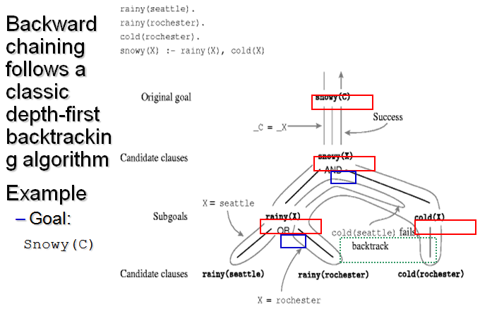
Backward Chaining in Prolog

